Slide 1
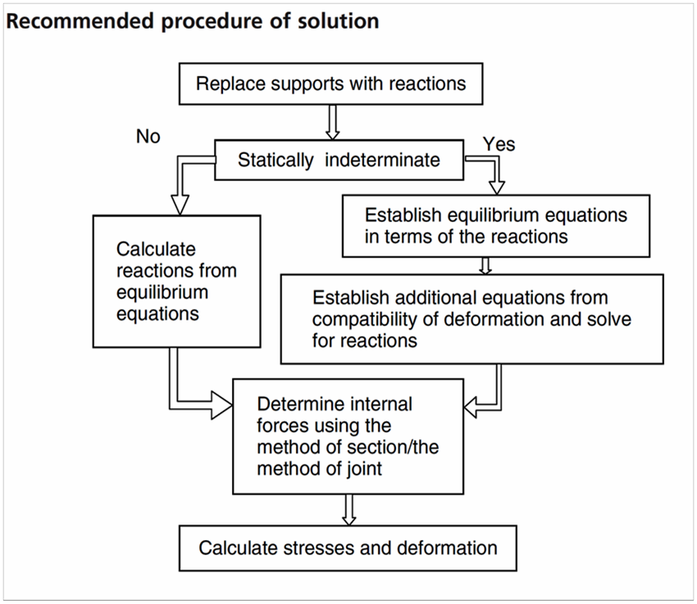
3.1 Stress Equation and Compatability
In Figure below, one can easily see that the overall elongation of the bar is zero since it is fixed at both ends. This is called geometric compatibility of deformation, which provides an additional equation for the solution of this problem. The total deformation of the bar is calculated considering the combined action of the two unknown support reactions and the externally applied loads.

Slide 2
Example

Slide 3
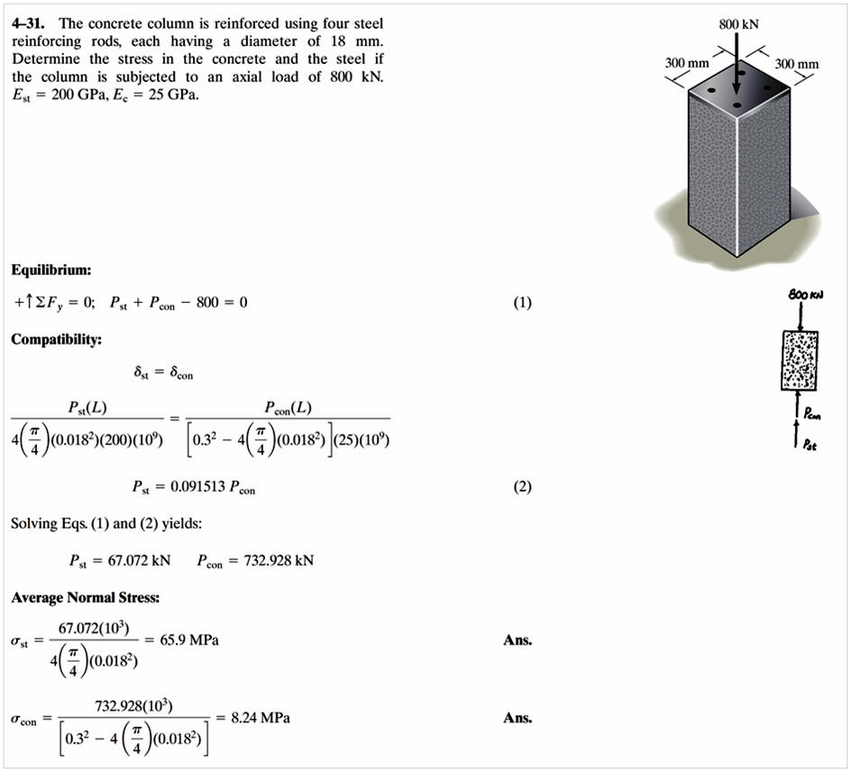

Slide 4
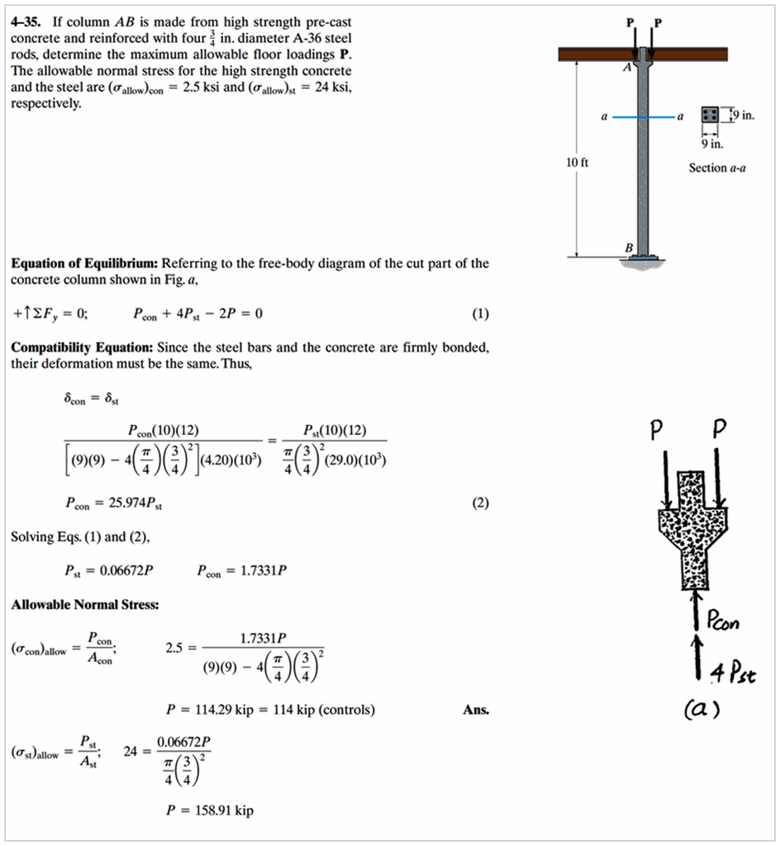
Example

Slide 5
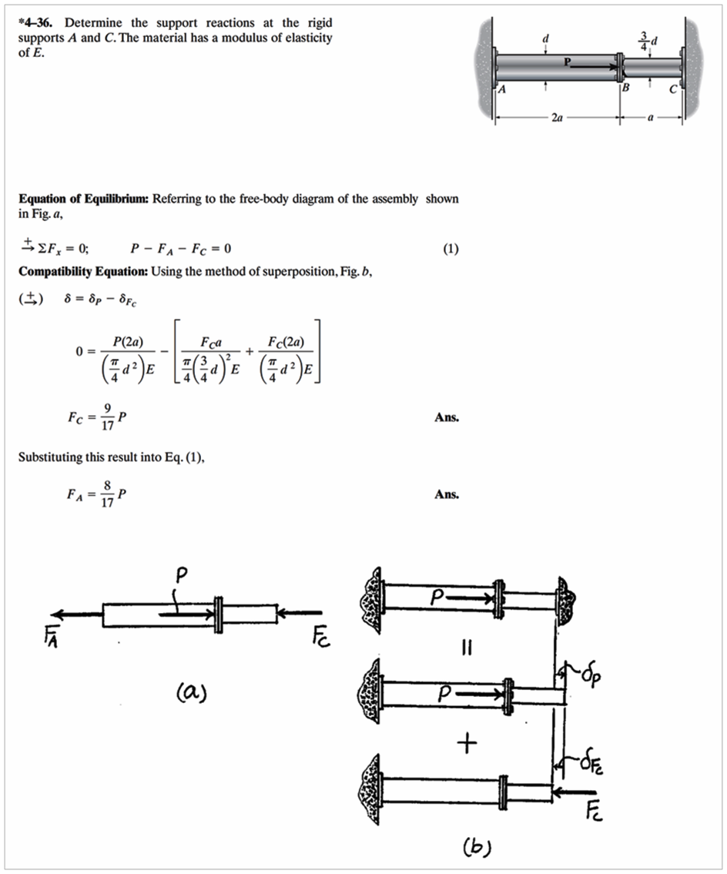
H.W

